Slide 1


Age ,Gender and Ethnicity detection system

Slide 2

Introduction & Data set description
We had about 23705 rows and 5 columns
Consists of about 199.7 MB
Has been extracted from Kaggle.
CSV of facial images that are labeled based on age, gender and ethnicity

Slide 3

01
02
03
04
Overview
Cleaned the data – null values removal, data type adjustment, Split the Pixel data and converted it into a single array list to feed into the model, Reshaped all the images into 48 * 48 matrix
Data Augmentation- Converted 23705 rows of data to 47410
Visualized the data and split it into train and test with 80-20. Built test model 1.
To improve the test model grouping method was used for age in addition to the existing categories of Gender, Ethnicity, and CNN, RNN models were built.
05
User input images were added to test the model performance. Results were tabulated.

Slide 4
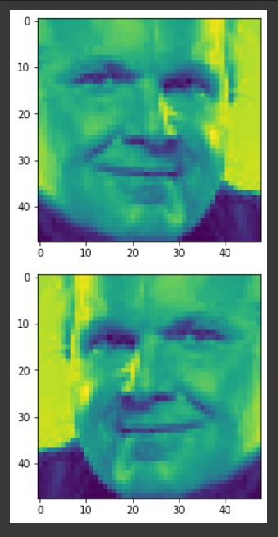
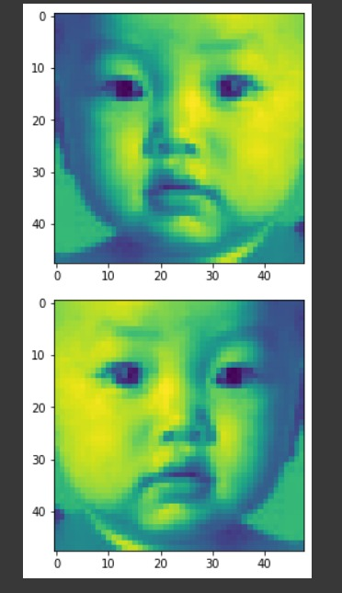
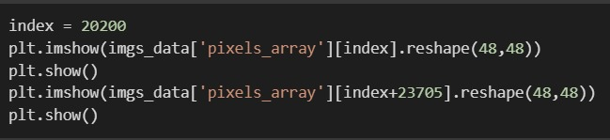
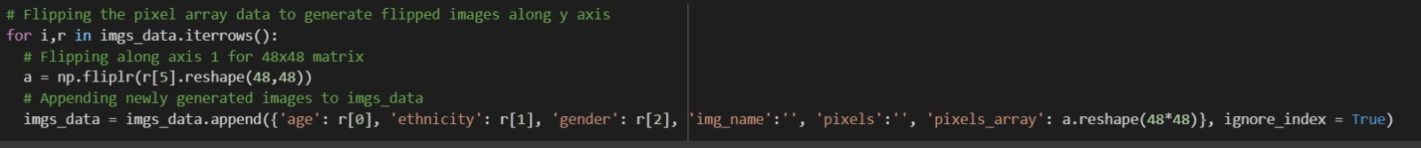
Data Augmentation
To train the model better and to improve accuracy pixel array was converted to an array and images were flipped on axis 0 to produce mirror images of the original image.

Slide 5

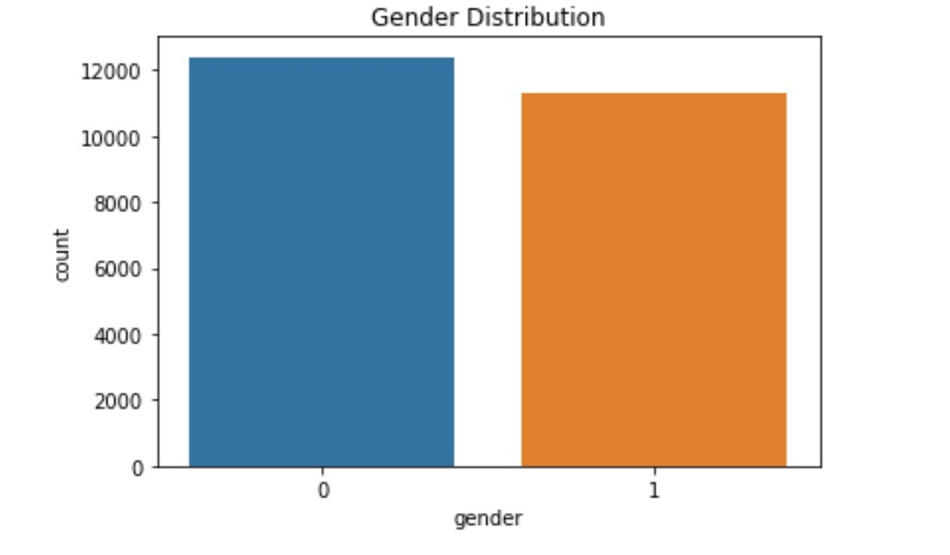
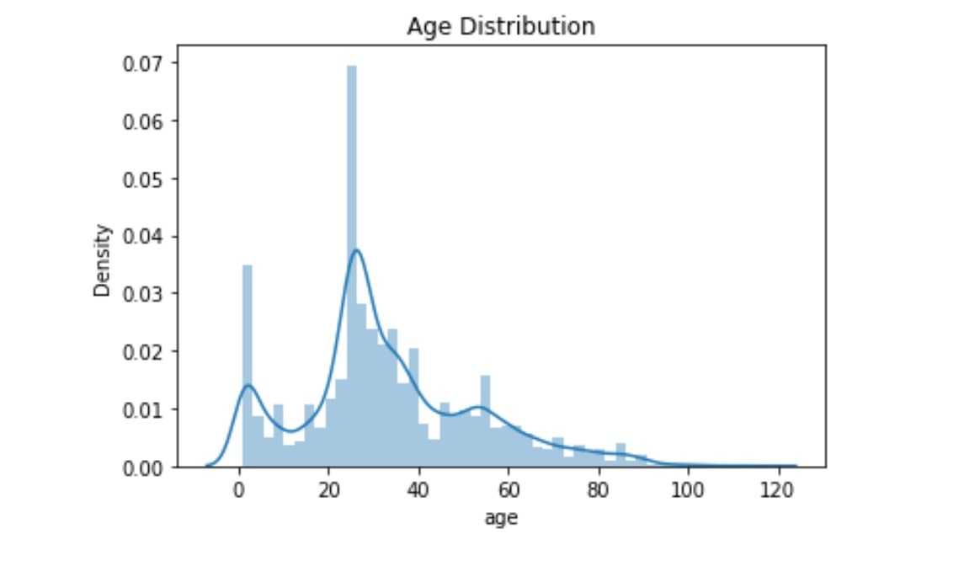
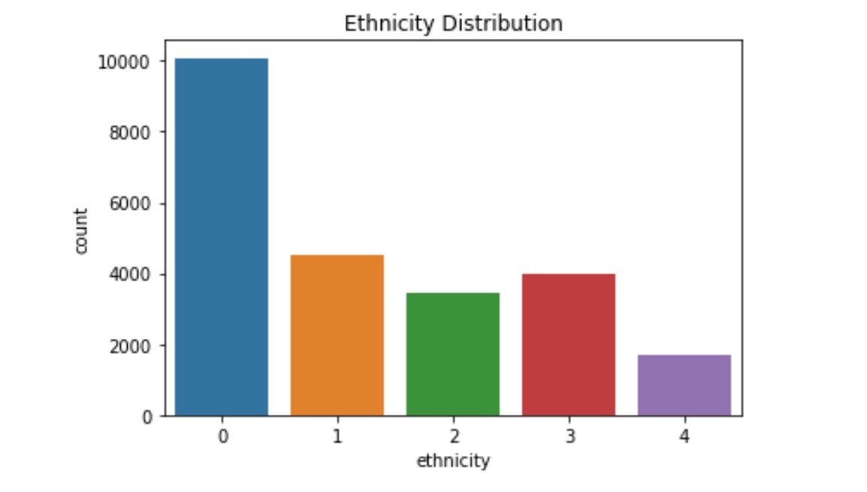
Visualization

Slide 6
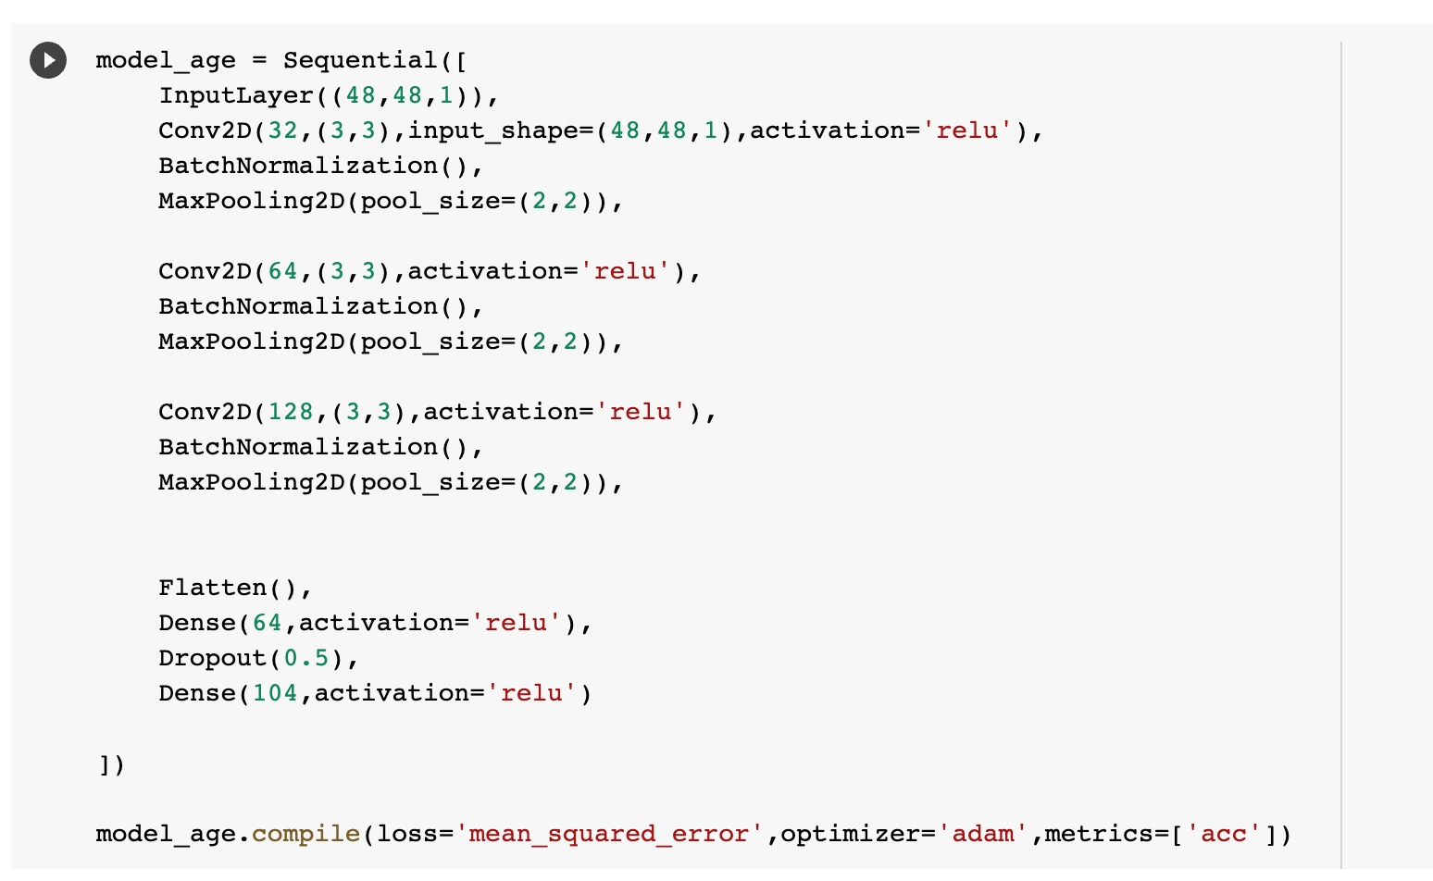
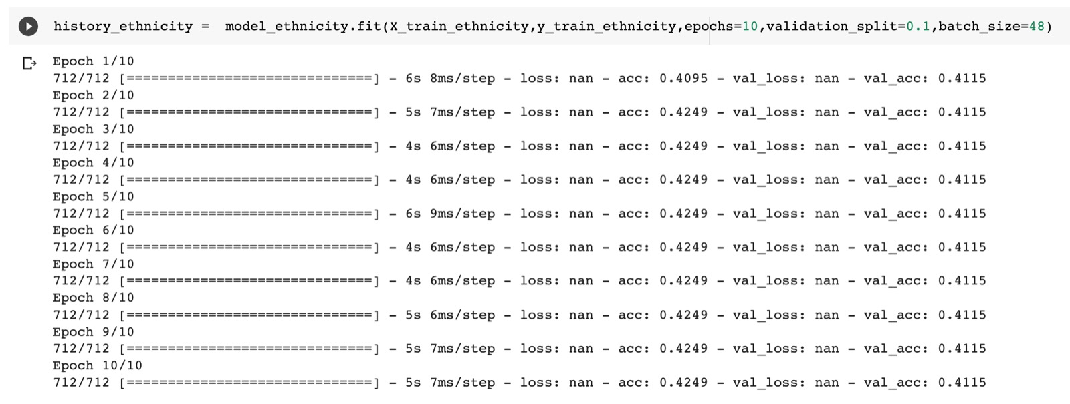
Data Splitting and initial model 1
Initial model
Output:
Age accuracy: <1%. , Gender accuracy: 89%, Ethnicity accuracy: 41.5%

Slide 7
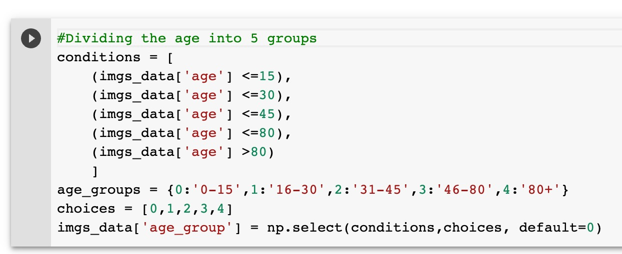
Grouping the data

Slide 8
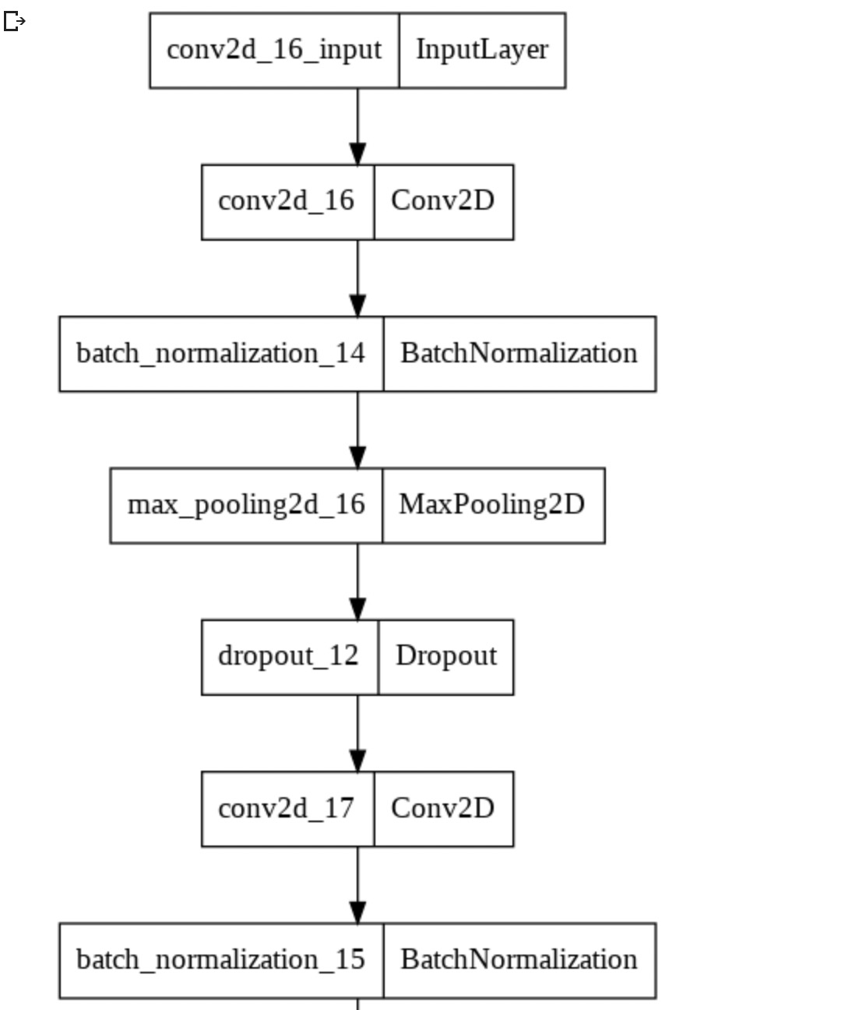
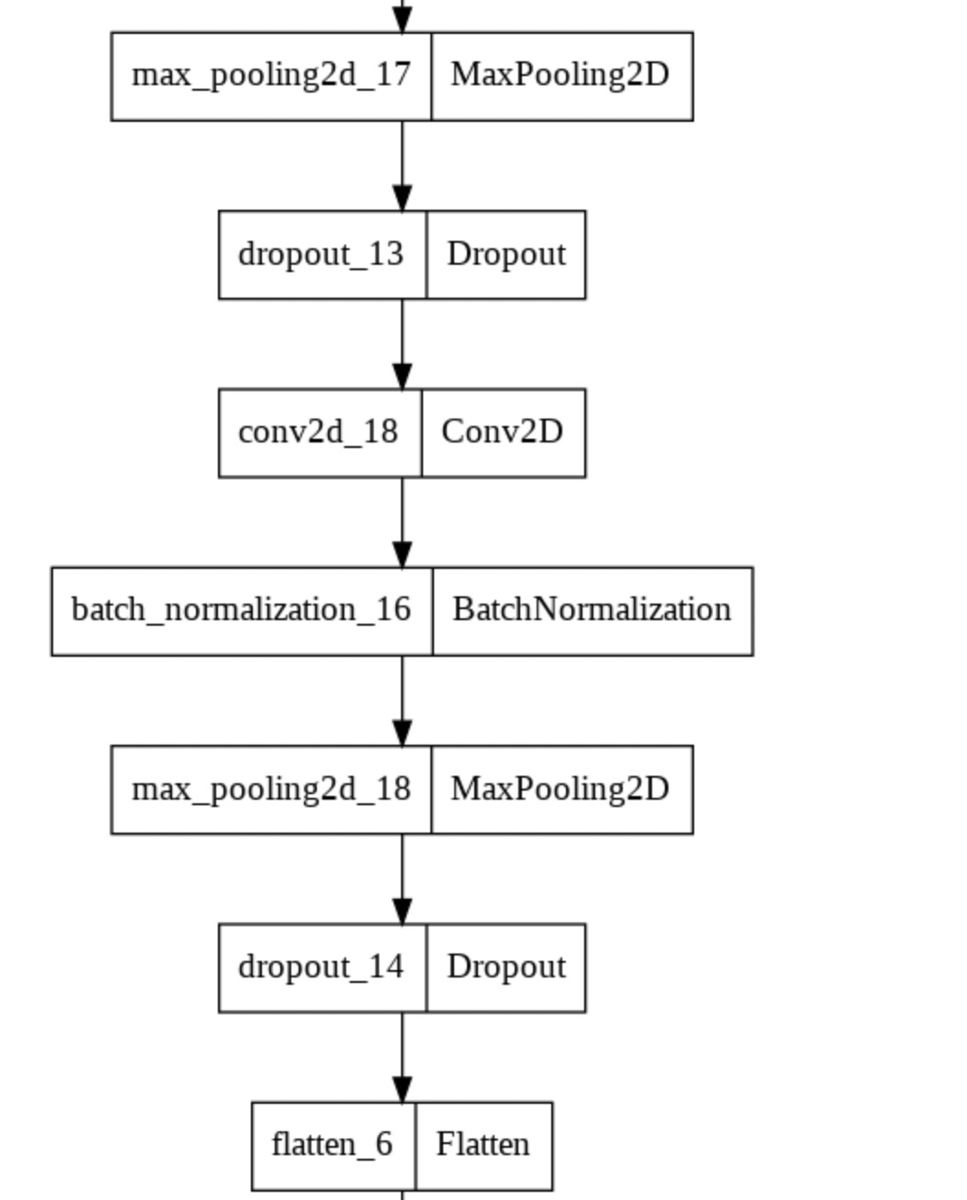
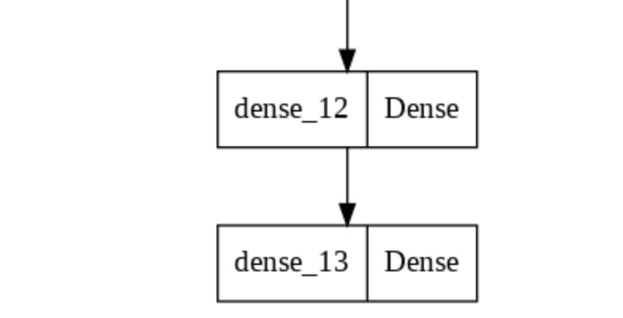
CNN Model Architecture

Slide 9
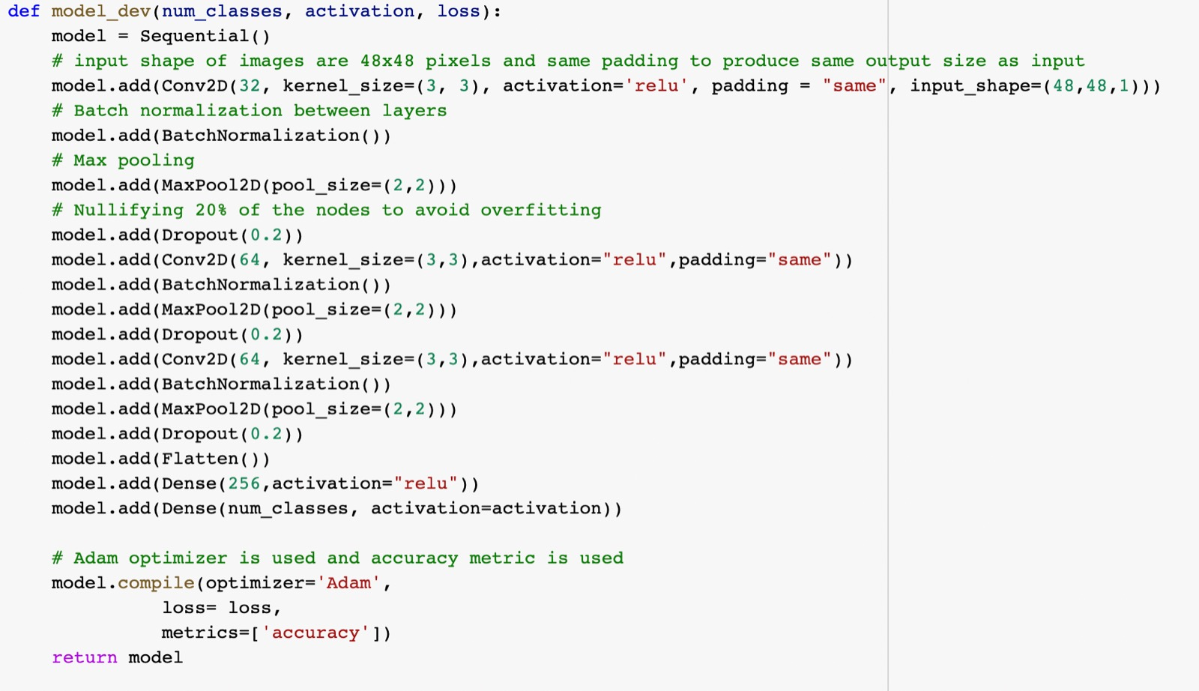
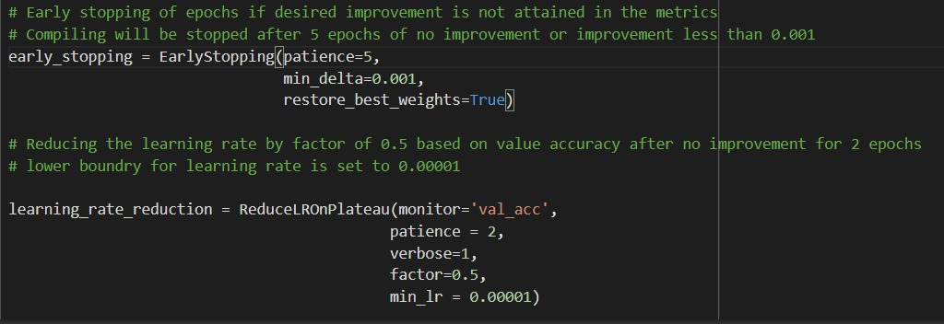
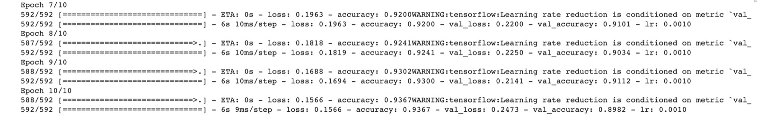
CNN model building
.
Defining the function – using early stopping and learning rate reduction
Calling function for gender

Slide 10
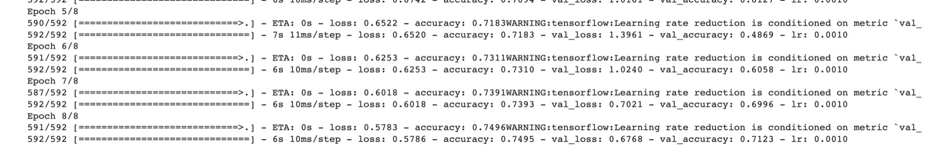
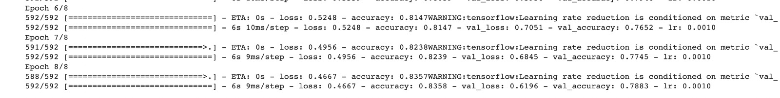
CNN model building
Calling function for age
Calling function for Ethnicity

Slide 11
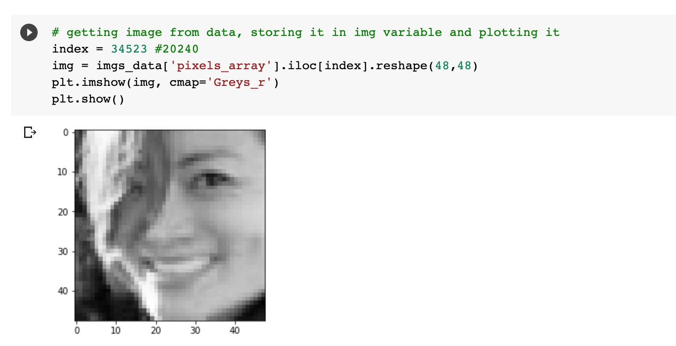
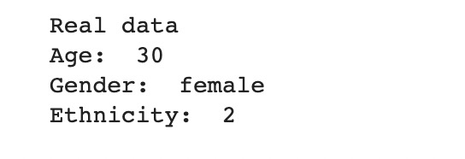
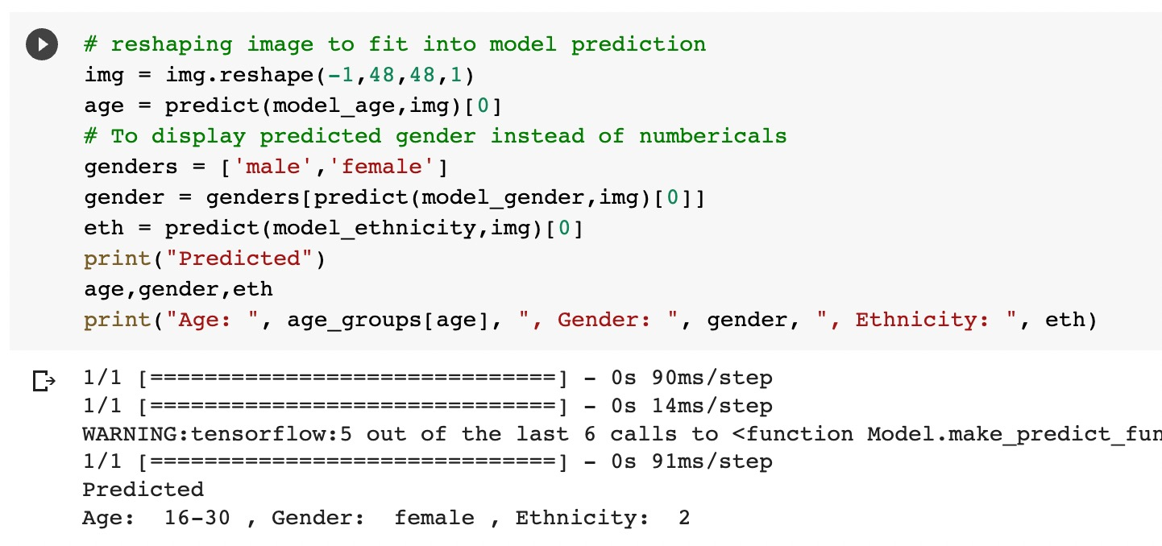
CNN model output
.
Comparing real vs predicted

Slide 12
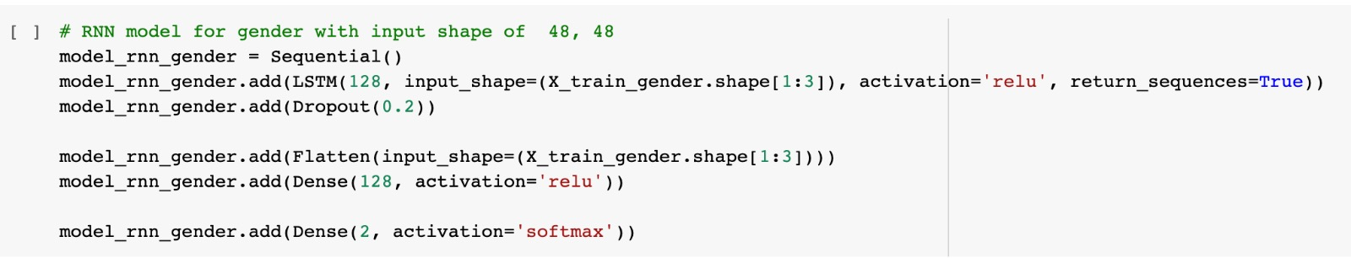
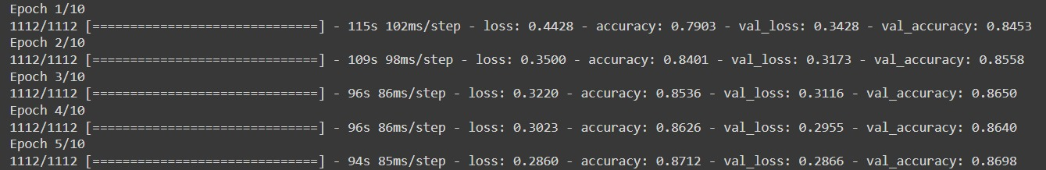
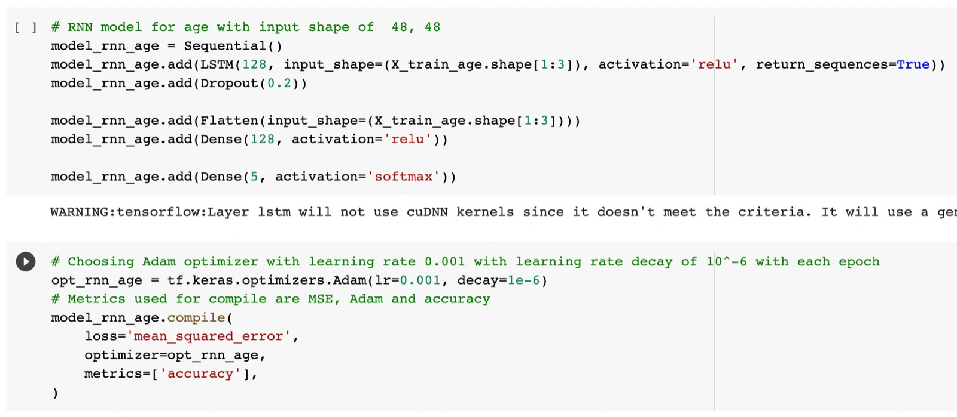
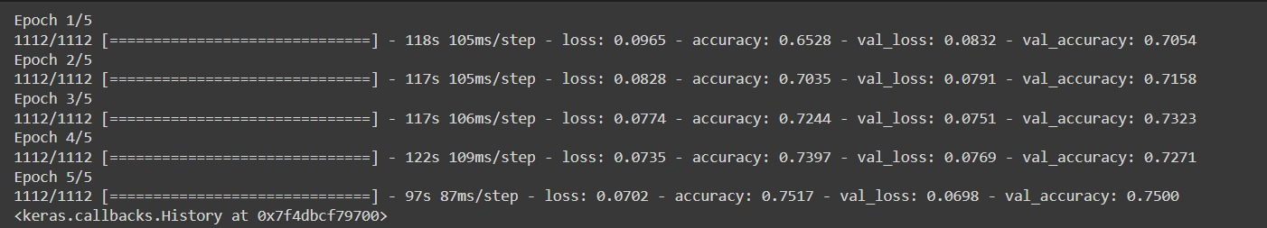
RNN model building
.
RNN for gender detection
Output:
RNN for age detection
Output:

Slide 13
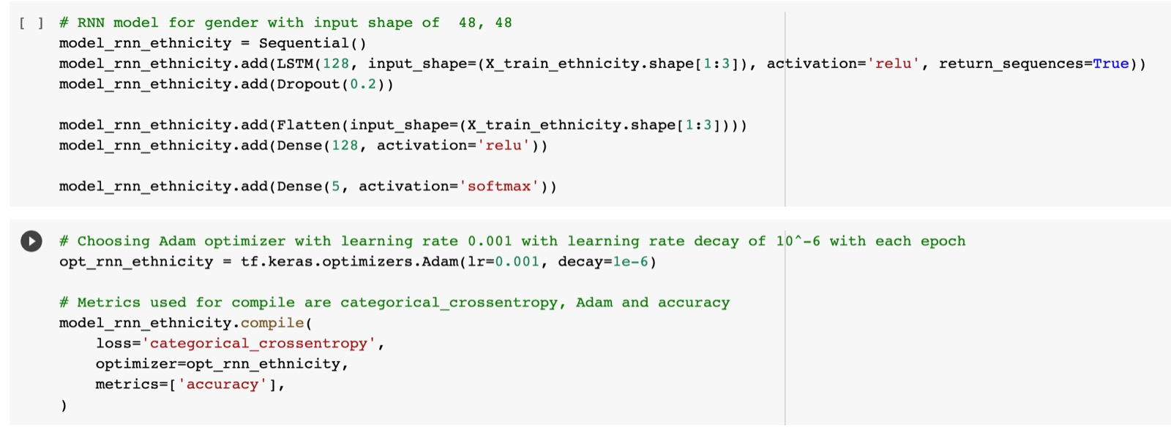
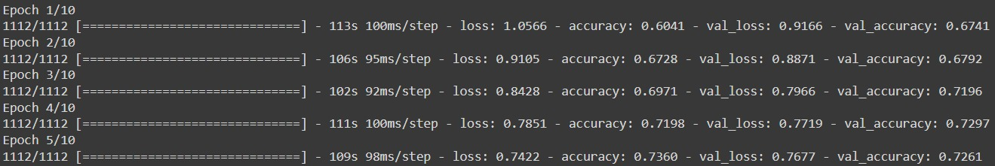
RNN model building
.
RNN for Ethnicity detection
Output:

Slide 14
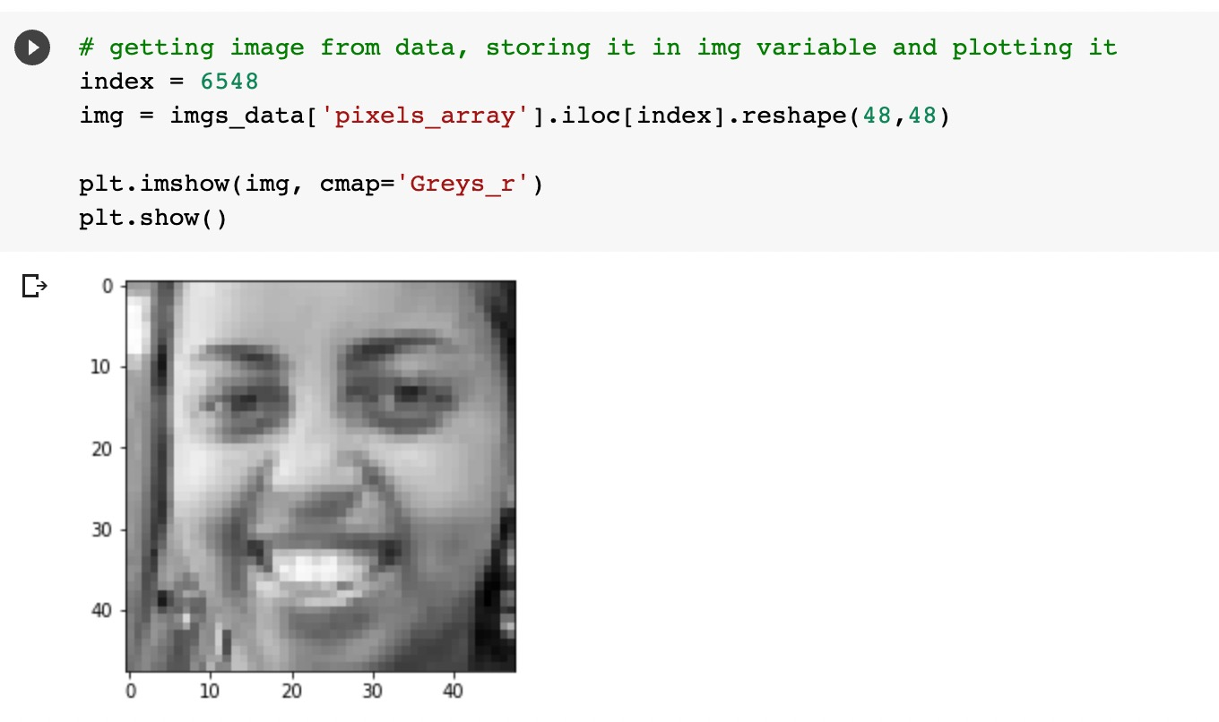
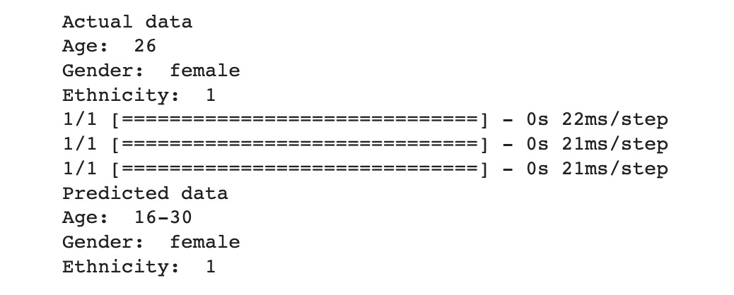
RNN model output
.
Comparing real vs predicted

Slide 15
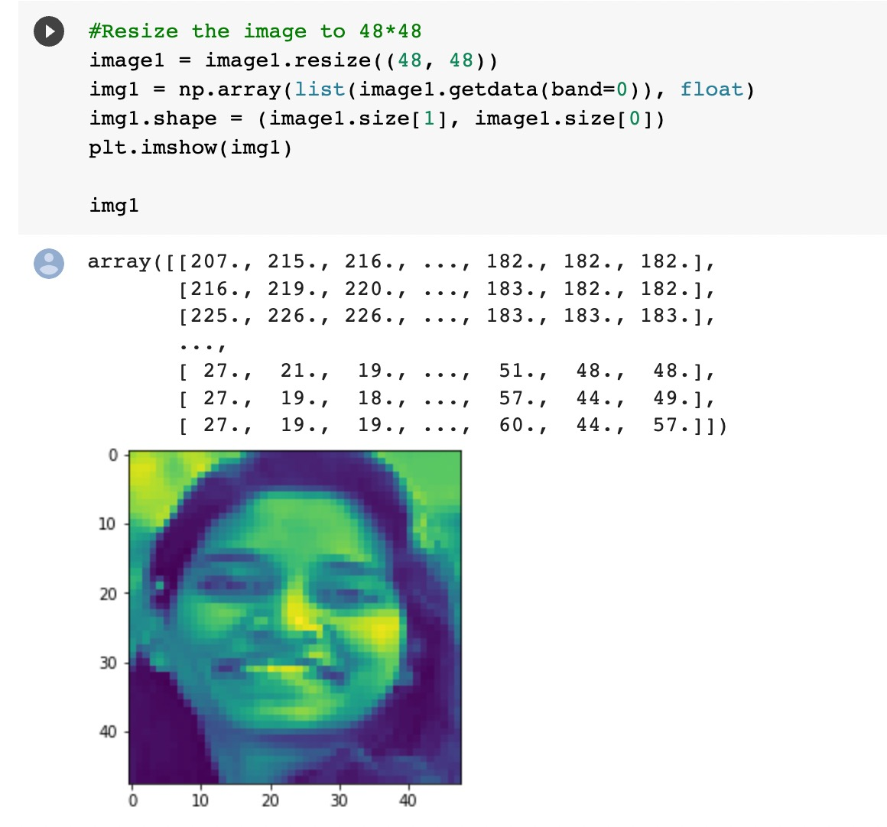

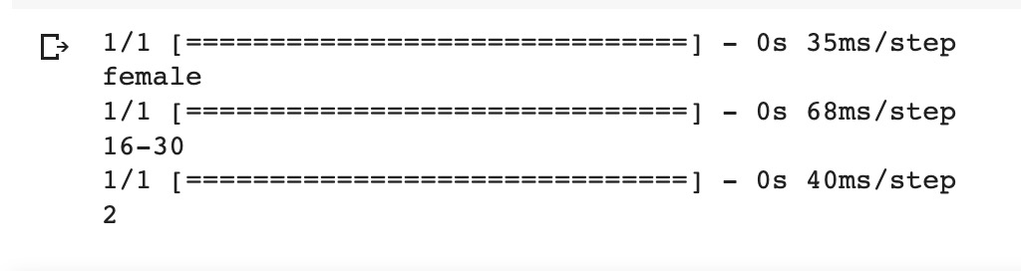
User input images
.
User input image 1

Slide 16
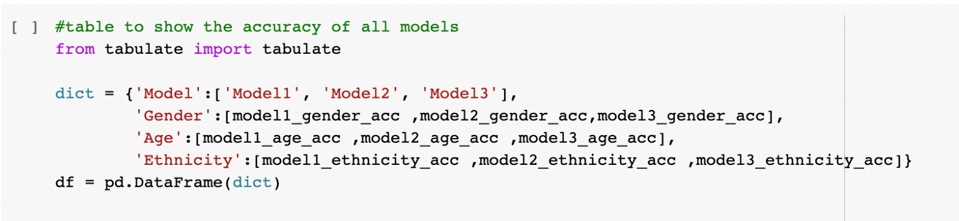
Comparison of Output
.
Output:
Model | Age | Gender | Ethnicity
Model 1 | <1% | 89% | 41.5%
Model 2 | 71.2% | 89.8% | 78.8%
Model 3 | 75% | 86.9% | 72.6%

Slide 17
THANKS!

